Slide 1


Department of Information Technology
QR-BASED CATTLE MANAGEMENT SYSTEM:
A PLATFORM FOR PERSONALIZED HEALTH MONITORING USING CHDI
Project Team Members:
Sabari Karthick A (61782323110093)
Sivanarasimman S (61782323110103)
Sujeeth Y R (61782323110107)
Project Guide:
Ms. J. Deepika
Assistant Professor
Department of Information
Technology

Slide 2
Abstract
Smallholder dairy farms need affordable tools for animal identification and health monitoring. This project presents a QR cattle management platform that links each animal to a digital profile and centralized health records. Its Composite Health Deviation Index (CHDI) evaluates body weight, feed intake, milk production and body temperature against an individual 14-day rolling baseline using multivariate Mahalanobis distance. Data-sufficiency checks, trend analysis and feature attribution support more meaningful alerts, while role-based interfaces connect farmers, veterinarians and administrators.
IDENTIFICATION
PERSONALIZED CHDI
VETERINARY FOLLOW-UP
Smartphone-scannable QR digital passports
14-day baseline + multivariate analysis
Role-based records, alerts and case review

Slide 3
Introduction
Smallholder dairy farms often depend on manual observation and paper records.
Delayed recognition of subtle health changes can affect animal welfare and milk productivity.
RFID readers and wearable monitoring devices may increase setup and maintenance costs.
One-size-fits-all thresholds can overlook normal differences between individual cattle.
Need: accessible digital identification combined with personalized, history-aware health assessment.
PROJECT FOCUS
Affordable, infrastructure-light cattle health management
FOUR HEALTH SIGNALS
Body weight • Feed intake • Milk yield • Temperature
INTENDED USERS
Farmers • Veterinarians • Administrators

Slide 4
Existing System / Literature Review
RESEARCH DIRECTIONS IN THE LITERATURE
Manual checks: depend on visible symptoms and periodic veterinary visits.
RFID / IoT collars: automate identification or sensing but require dedicated hardware.
Fixed thresholds: may not account for breed, lactation stage or individual baselines.
Separate registers and applications: fragment vaccination, treatment and health histories.
QR collars and digital passports for non-invasive animal identification.
PLF, IoT and multimodal datasets for continuous livestock monitoring.
Machine learning and multivariate anomaly detection for health assessment.
Personalized anomaly detection and abstention when data are insufficient.

Slide 5
Objective of the project work
Create a unique QR-based digital identity for every registered animal.
Centralize cattle profiles, health observations, vaccination and veterinary records.
Build a personalized 14-day rolling baseline for four core health parameters.
Calculate CHDI using standardized deviations and multivariate Mahalanobis distance.
Use data-sufficiency checks, 7-day trend analysis and LOCO feature attribution.
Provide role-based workflows for farmers, veterinarians and administrators.
Evaluate the prototype using the available longitudinal cattle dataset.

Slide 6
Proposed System
A cloud-based, sensor-optional platform connecting animal identity, health records and veterinary action.
1 REGISTER
2 RECORD
3 ANALYZE
4 EXPLAIN
5 RESPOND
Create cattle profile and unique QR token.
Log weight, feed, milk and temperature.
Compare observations with the animal’s 14-day baseline.
Generate CHDI status, trends and contributing signals.
Route at-risk cases for veterinary review and feedback.

Slide 7
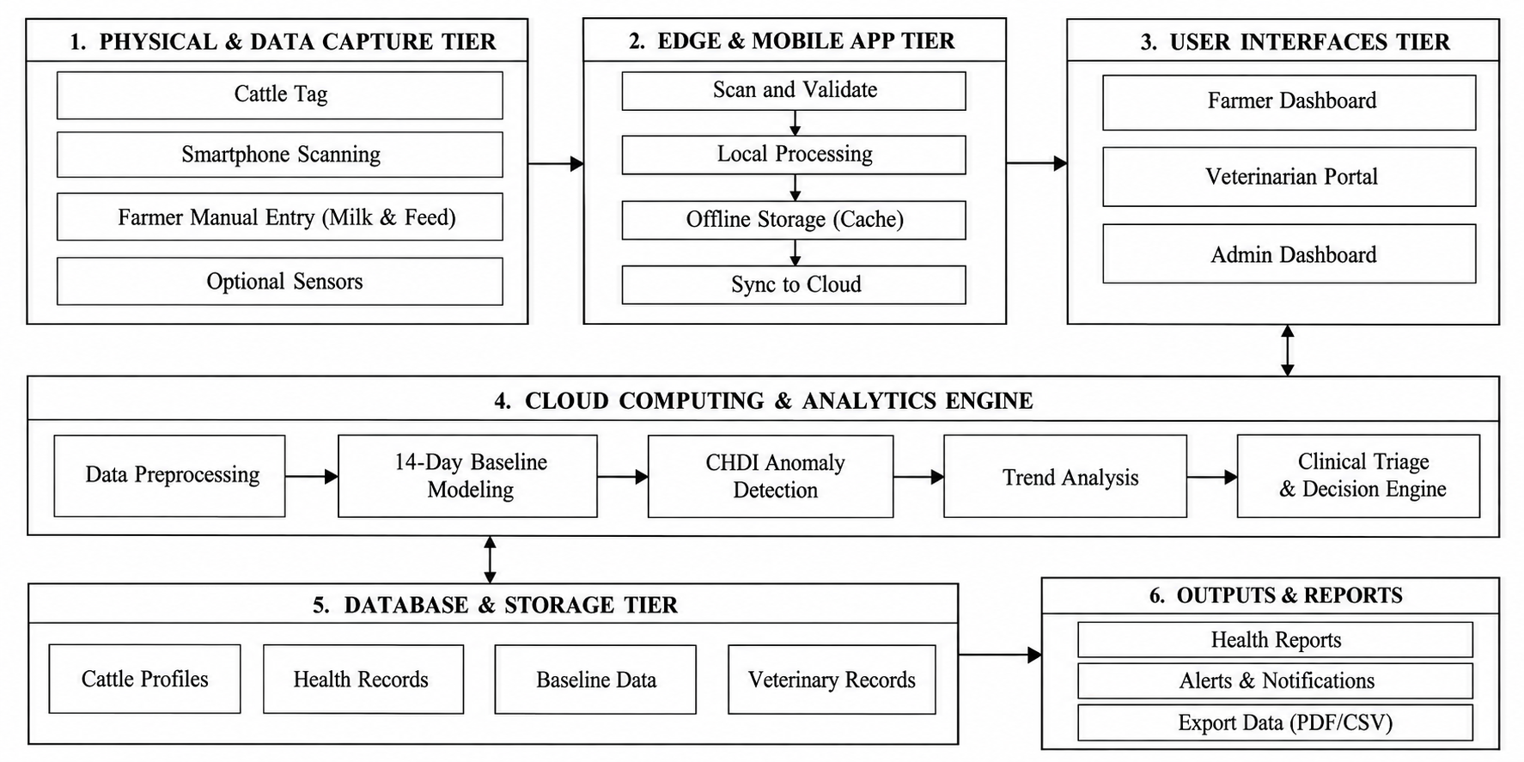
Architecture Diagram

Slide 8
Technology Used
Frontend
Backend & API
Next.js 16 • React 19 • Tailwind CSS
Next.js API routes • Node.js • REST APIs
Database
Analytics
PostgreSQL (Neon Serverless) • Prisma ORM
Python • FastAPI • NumPy • SciPy • Pandas • Scikit-learn
QR generation
Hardware
qrcode (npm) • HTML5 Canvas
Smartphone camera • Laminated / UV-resistant QR tag • Cloud server

Slide 9
Module Description
01 Authentication & RBAC
02 Cattle Identification
Separate farmer, veterinarian and administrator permissions; protect routes and sensitive record updates.
Register animals, manage breed and lactation details, and issue a unique QR digital passport.
03 Health Data Logging
04 Medical & Vaccination
Capture body weight, feed intake, milk production and core temperature as timestamped records.
Maintain vaccination, deworming, diagnosis, treatment and follow-up information.

Slide 10
Module Description
05 Baseline & CHDI
06 Health Trends & Analytics
Build 14-day rolling statistics, normalize signals and calculate covariance-weighted Mahalanobis distance.
Review 7-day and 30-day history and identify changing CHDI patterns.
07 Explainability
08 Veterinary Alerts & Feedback
Use leave-one-covariate-out (LOCO) attribution to show which signals contribute to an alert.
Prioritize cases, assign veterinary review, record diagnosis/treatment and capture verified feedback.

Slide 11
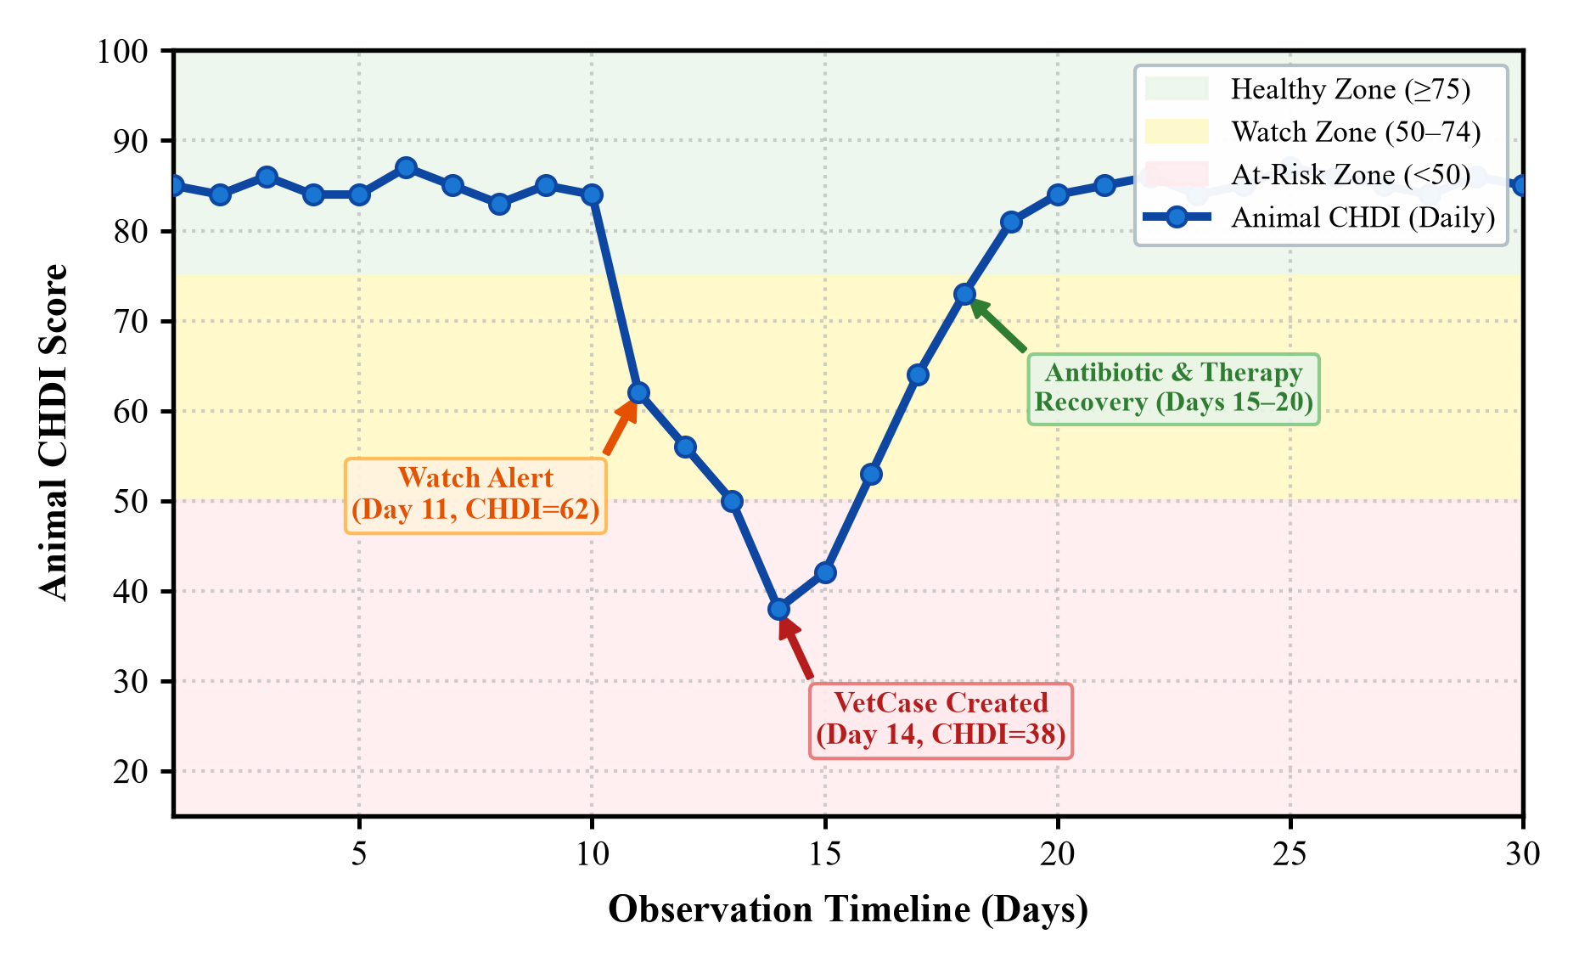
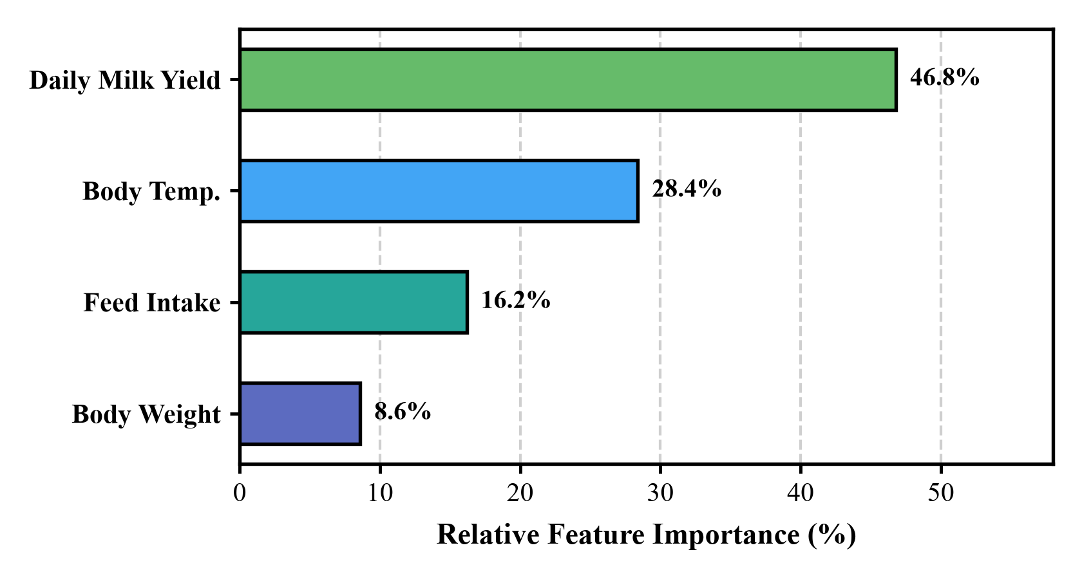
Results & Discussion
PROPOSED MAHALANOBIS CHDI — REPORTED PERFORMANCE
91.20%
96.85%
88.50%
89.82%
Sensitivity
Specificity
Precision
F1-score

Slide 12
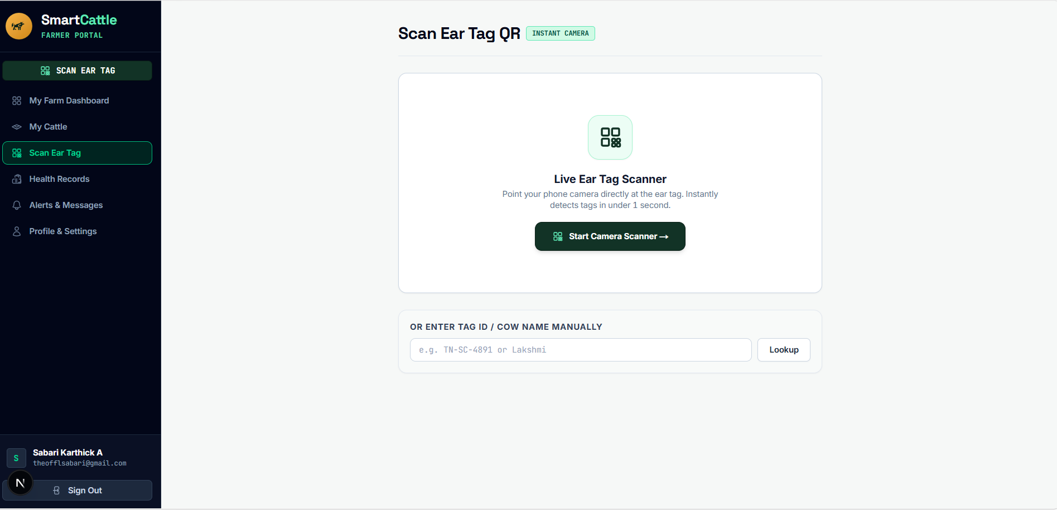
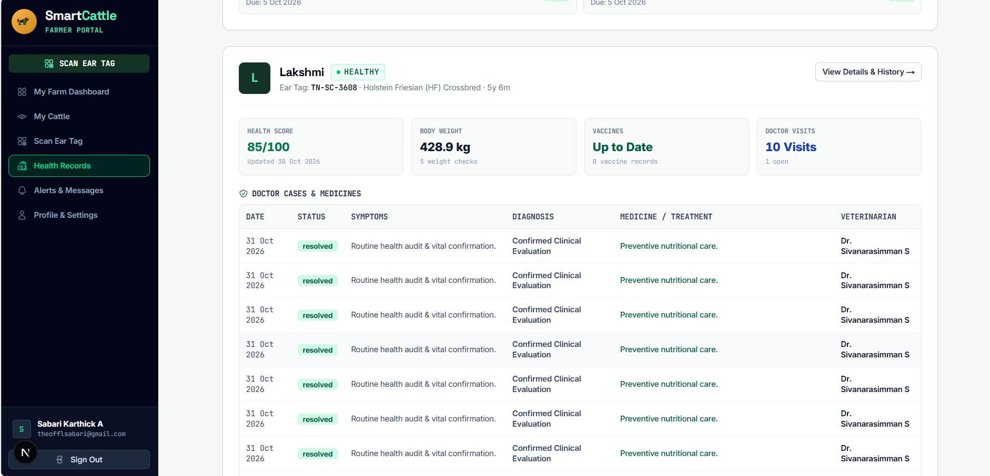
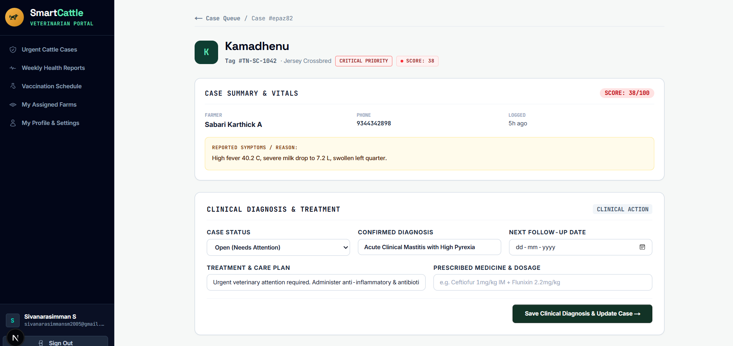
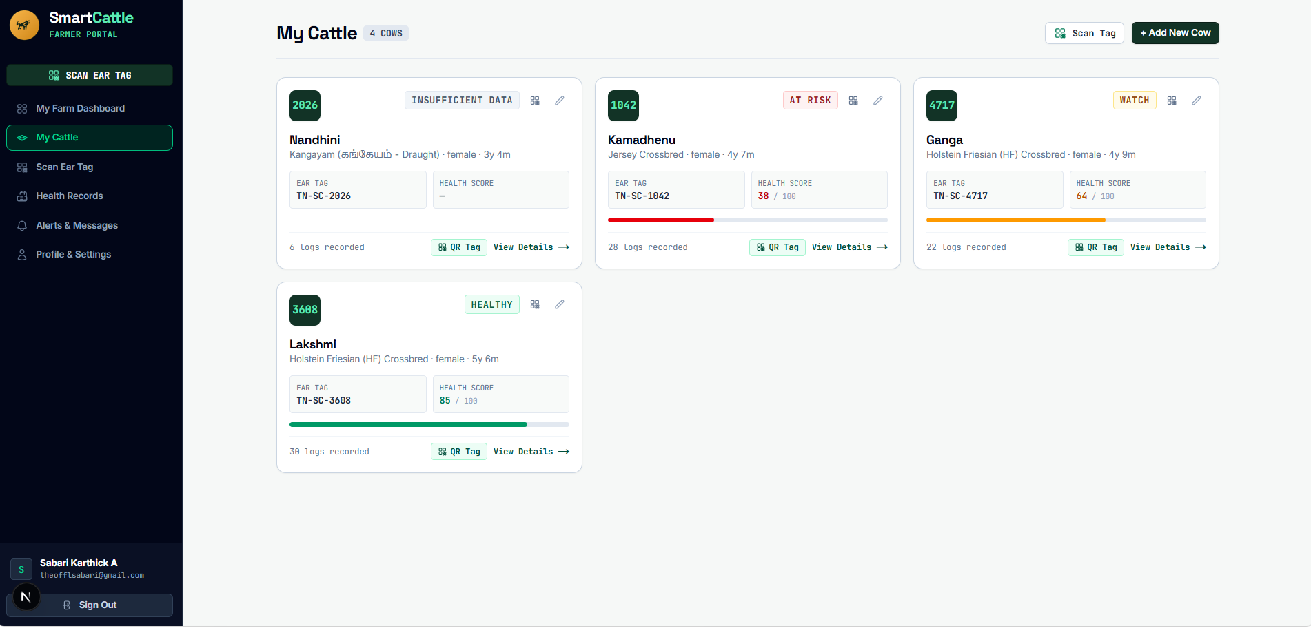
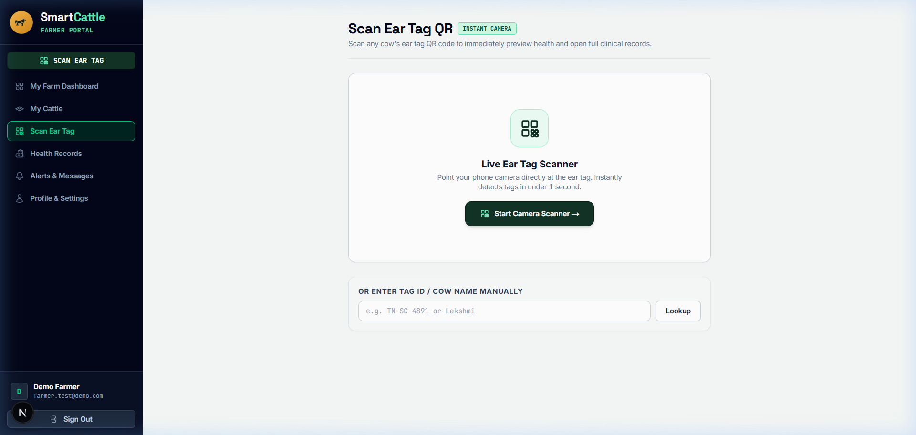
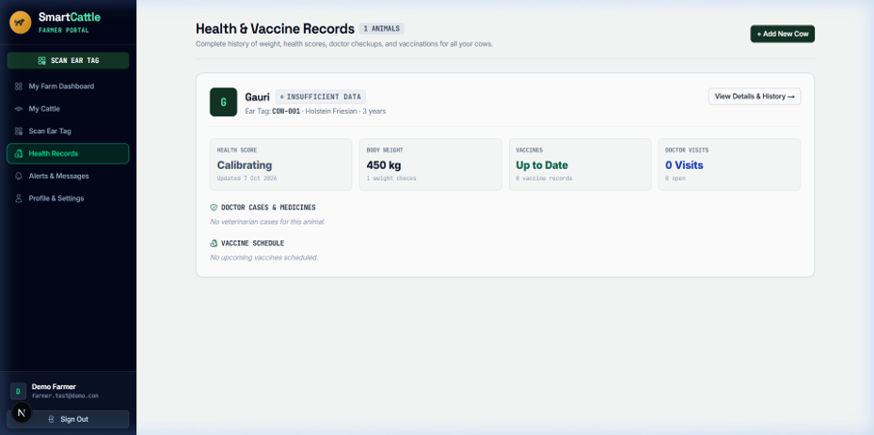
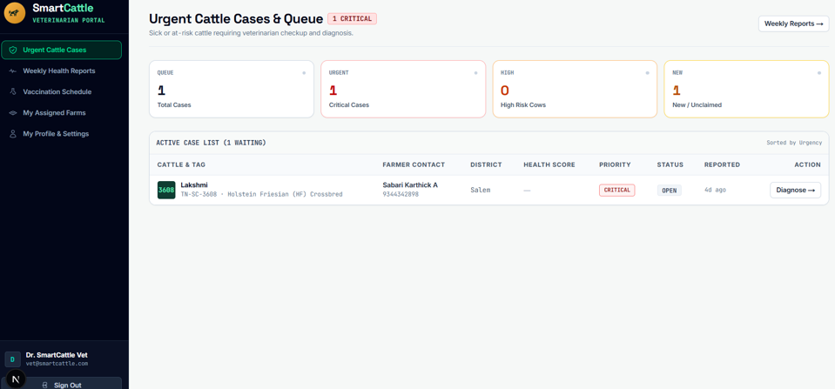
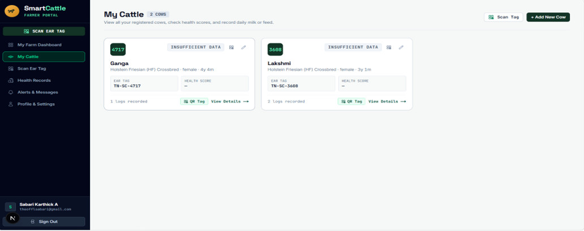
Screenshots
QR scanner / digital identity
Health & vaccine records
Veterinary case queue
Cattle herd roster

Slide 13
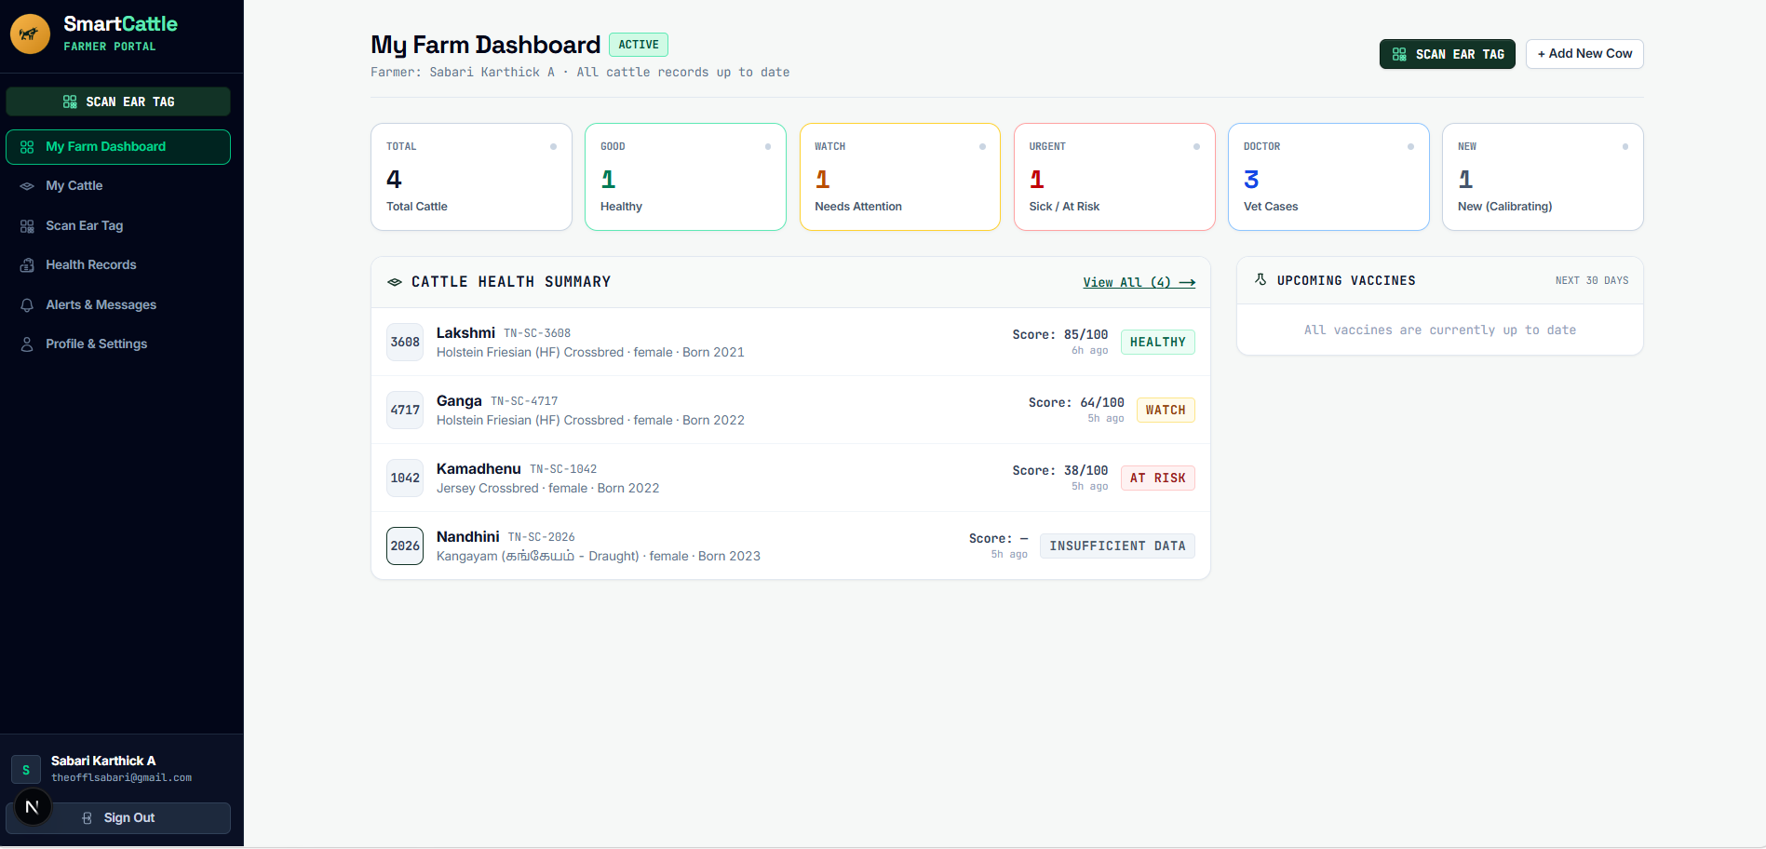
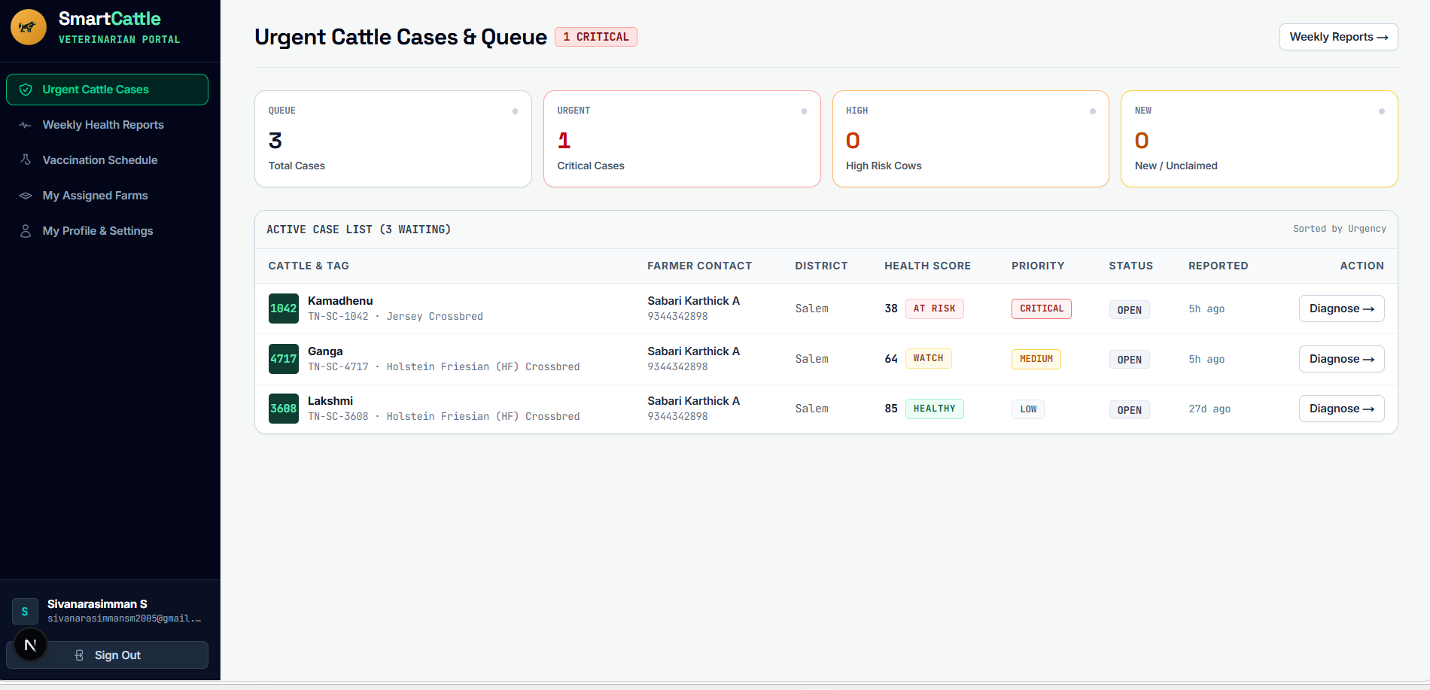
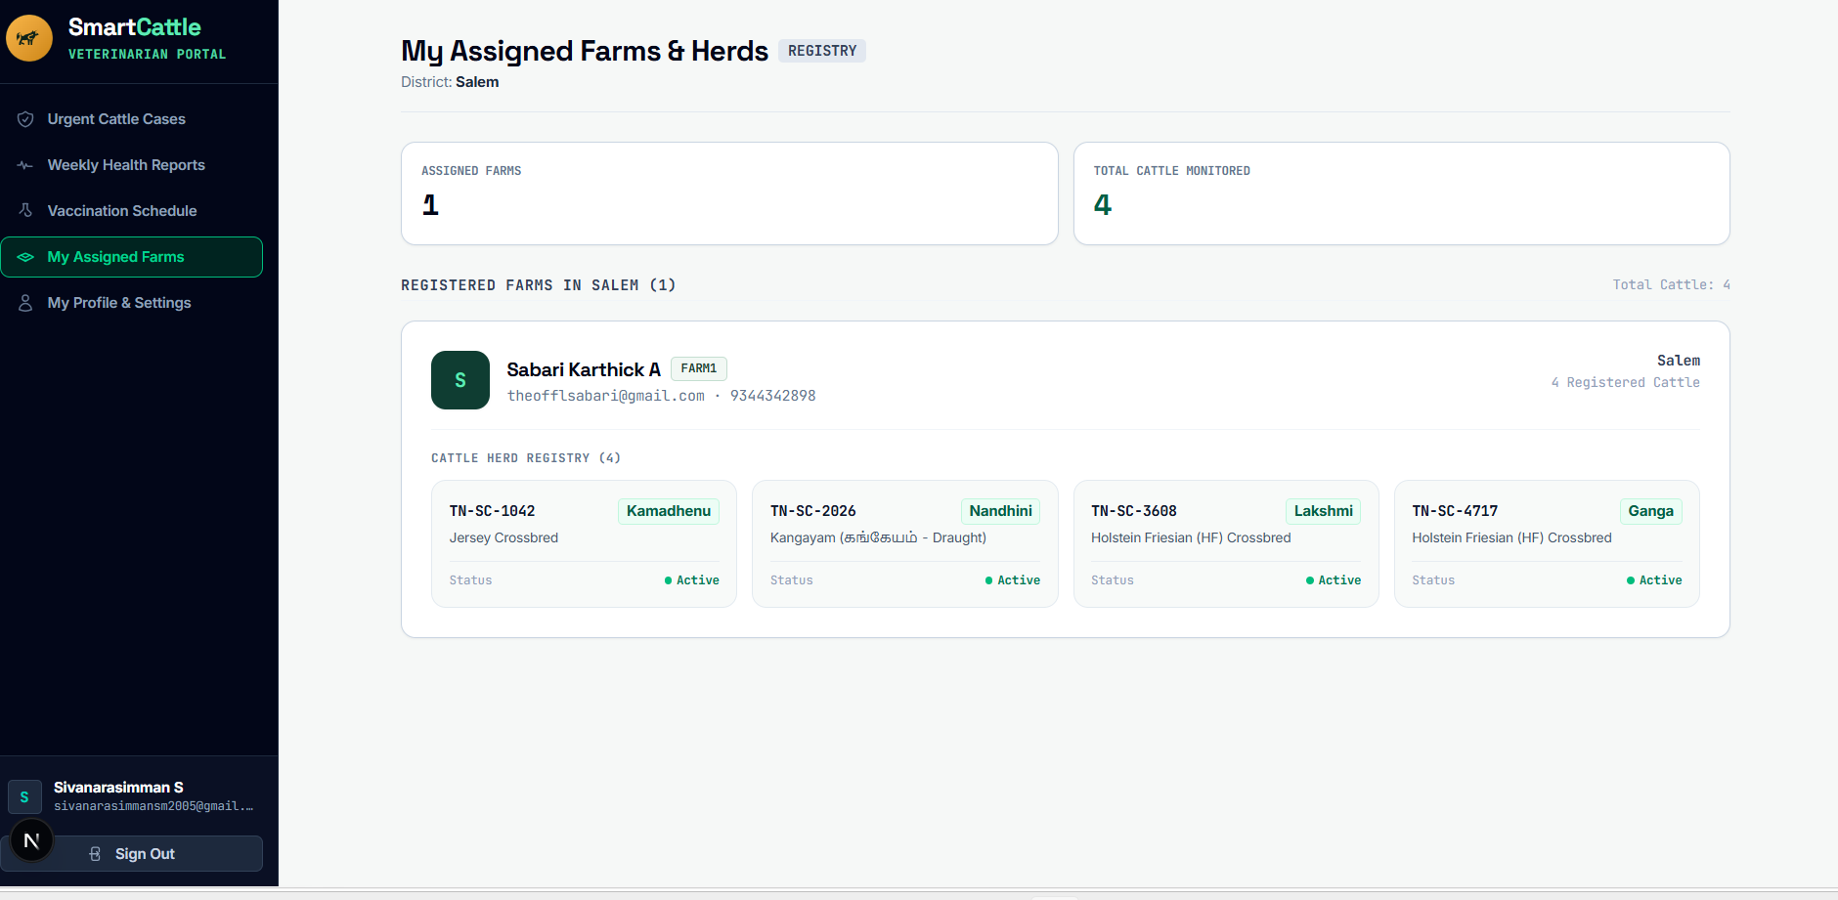
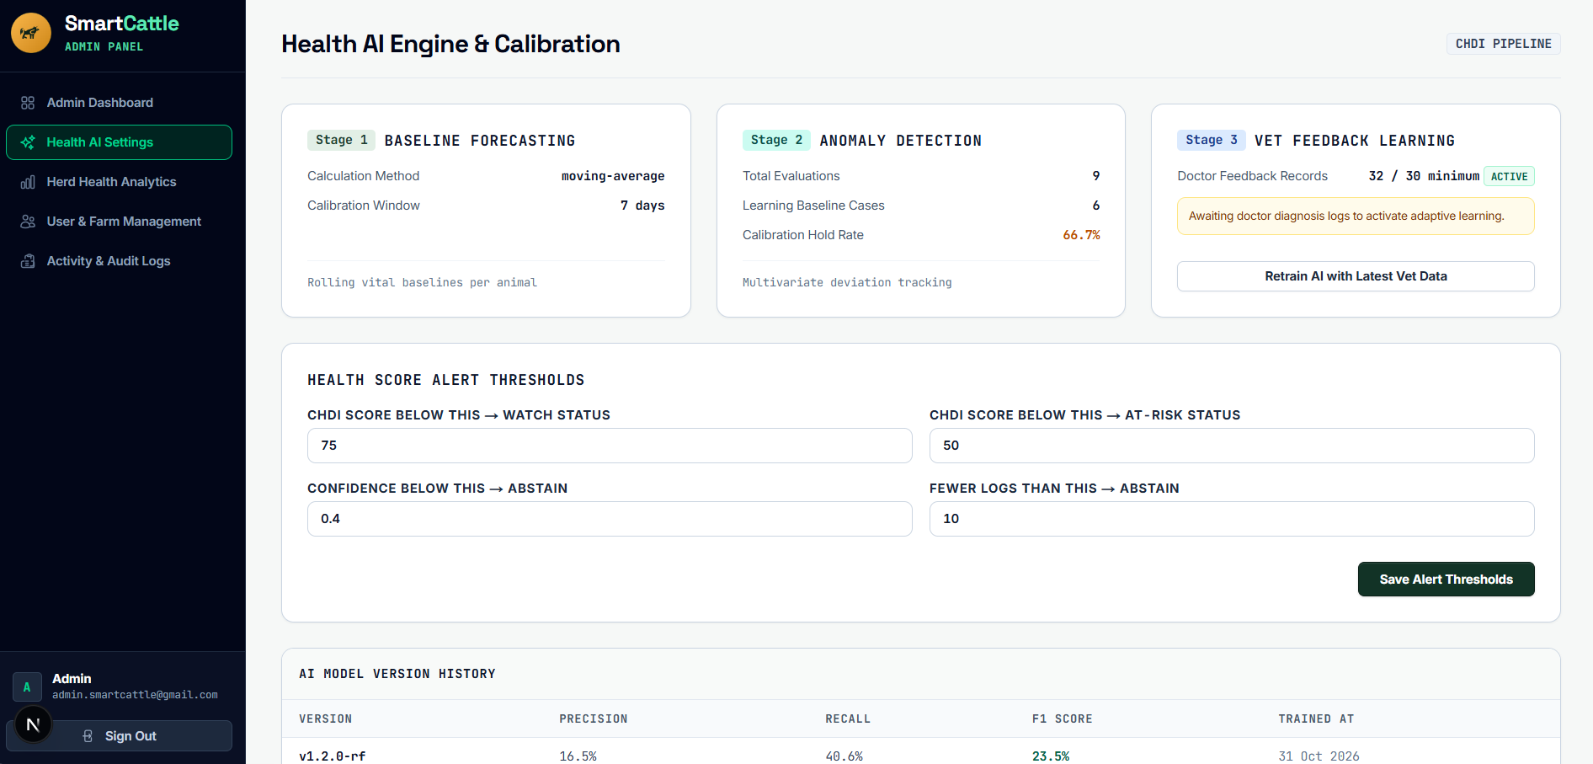
Screenshots — Triage & AI Engine
Farmer herd dashboard & health summary
Urgent cattle triage queue
Regional veterinary coverage (Salem)
3-Stage AI engine & model calibration
31-10-2026
13

Slide 14
Conclusion
FUTURE ENHANCEMENTS
The prototype combines QR-based cattle identity, centralized digital records and personalized CHDI assessment. The reported evaluation indicates improved detection performance over the compared threshold-based and univariate approaches. It can support earlier identification of unusual health patterns and structured veterinary follow-up.
SMS and WhatsApp alerts for cattle health risks and veterinary appointments.
Voice-based health logging in Tamil, Hindi and other regional languages.
Offline-first data capture and synchronization for low-connectivity farms.

Slide 15
References
[1] Ankitha et al., IoT and thermal-imaging approaches for clinical mastitis detection.
[2] Aquilani et al., Review of Precision Livestock Farming technologies in pasture-based systems.
[4] Bumbálek et al., Non-invasive cattle identification methods, including QR-code collars.
[5] Curti et al., Machine-learning approaches using individual cow health records.
[7] Fan et al., Personalized anomaly detection for physiological telemetry.
[8] Garg et al., Multiparametric machine-learning models for early bovine disease prognosis.
[10] Hostens et al., Longitudinal dairy-cattle production and physiological dataset.
[15] Mehta et al., Selective classification and abstention in clinical machine learning.
[16] Pereira et al., Review of passive UHF RFID technologies for animal tracking.
[20] Waldron, Statistical frame theory and multivariate anomaly detection in biotelemetry.

